Slide 1
BEAST2 and the Protracted Birth-Death model
By Femke Thon & Jolien Gay
Supervisors:
Richel Bilderbeek & Rampal Etienne
Notes:
NOTE: Some photo’s are placeholders (incomplete pics).

Slide 2
Research Question
“Can BEAST2 accurately recover a ‘true’ tree?”
Notes:
Moeten we het nog eens uitgebreid over hebben. Hier staat vermoedelijk nog een ‘hogere’ vraag boven. De onderzoeksvraag hoeft ook niet in één keer alles te zeggen.

Slide 3
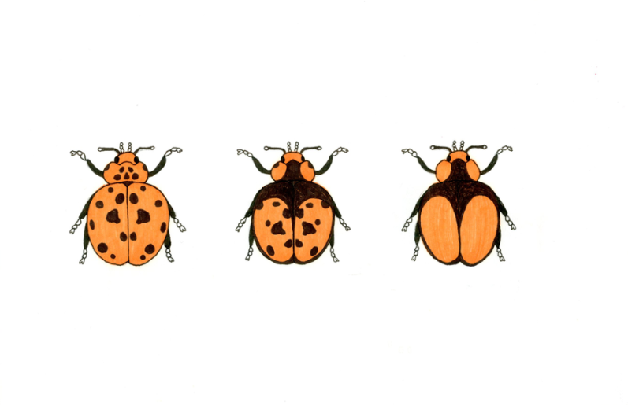
Introduction: What?
Speciation
Evolutionary process
Population -> distinct species (reproductive isolation)
Models
-> Tools needed!

Slide 4

Introduction: What?
Bayesian Evolutionary Analysis by Sampling Trees (BEAST)
Bayesian statistics
Markov Chain Monte Carlo (MCMC)
Multiple speciation models can be applied
All assume instant speciation
Posterior
Prior
Likelihood
Marginal probability

Slide 5
Introduction: What?
Standard Birth-Death model (BD)
Instant speciation
Constant speciation and extinction rates
Number of lineages increase constant or accelerated (pull of the present)
BUT: slowdown observed towards the present

Slide 6
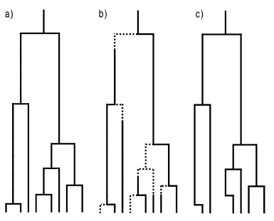
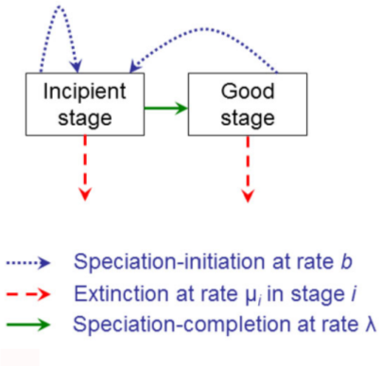
Introduction: What?
Protracted Birth-Death model (PBD)
Extension of BD
Assumes speciation takes time
Etienne and Rosindell (2012)

Slide 7
Material & Methods
Material:
Simulated PBD parameter files
BEAST2
R
Summary statistics
GitHub
Methods: 5 steps

Slide 8
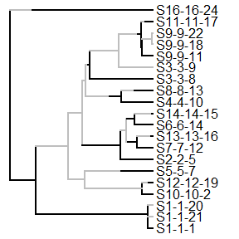
1. Create ‘true’ species trees (simulated)
Create parameter files
Simulate incipient tree/parameter file

Slide 9
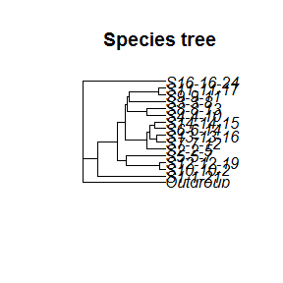
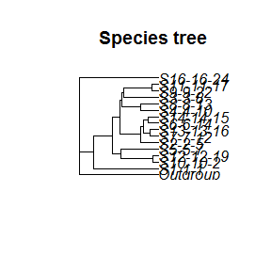
2. Sample a (monophyletic) species trees
Sample unique species from incipient tree (once or more)
Simulate incipient tree / parameter file
Notes:
Outgroup may be unnecessary. Constant clock rate used.
TODO: Make species names better visible
TODO: Add clearer title to pictures (Sampled tree 1 and 2)

Slide 10
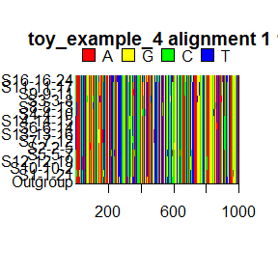
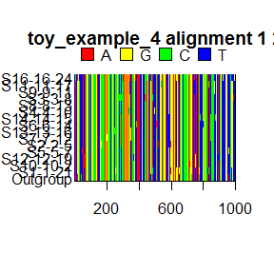
3. Convert to DNA alignment
Input BEAST2
Simulate alignment from species tree (once or more)
Notes:
TODO: Clearer titles, show that these are 2 random draws sampled tree 1
Q: Should we show the 2 drawn alignments from sampled tree 2 also? Not too much stuff happening in one dia?

Slide 11
4. Infer a posterior (BEAST2)
Output BEAST2
Posterior / alignment (again, once or more)
Notes:
TODO: Find picture of posterior Toy example 4

Slide 12
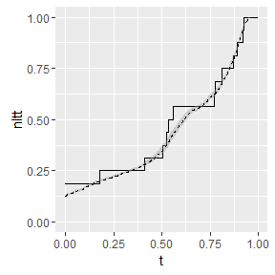
5. Analysis
Compare posterior with true species tree (from step1)
Collect summary statistics (gamma, ....)
Notes:
TODO: Add legend

Slide 13
Main Question
“Can BEAST2 accurately recover a ‘true’ tree?”
Sub questions
Error big enough?
Right summary statistics used?

Slide 14
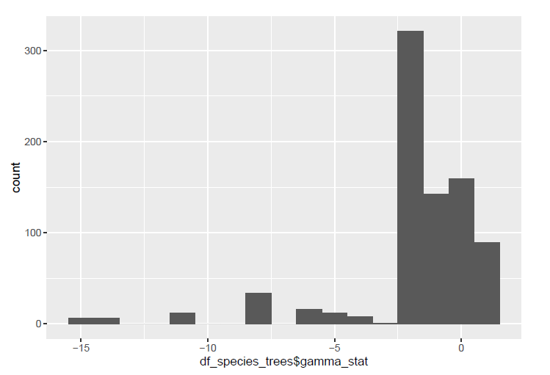
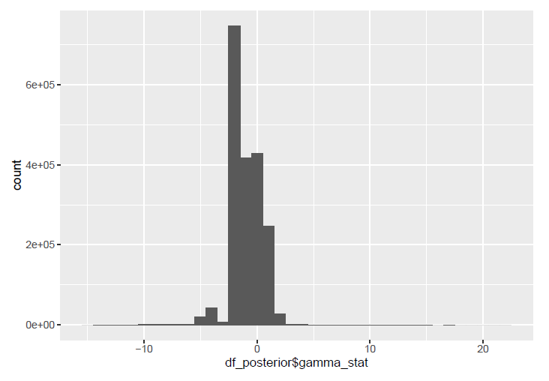
Results
Distribution of gamma statistics

Slide 15
Results
Distribution of ... (Femke)

Slide 16
Discussion
Error gamma statistics: substantial
Error ....: ??

Slide 17
Conclusion(s)
Errors big enough BUT:
Correct gamma statistics used?

Slide 18
Questions?
Notes:
POSSIBLE QUESTIONS?:
Q1: Why did you use an outgroup?
Q2: Are the used summary statistics the best, and why?

